Slide 1

Lecture 1
Introduction

Slide 2
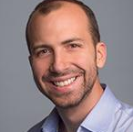
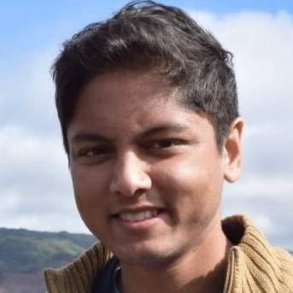
Welcome to Data 8
Joseph
Gonzalez
Swupnil Sahai
Where to find Joseph:
Calendly Office Hours (Soda 773)
Other OH options coming soon…
Where to find Swupnil:
4pm-6pm Monday at FSM Café
data8.org/sp23/staff

Slide 3
Data Science

Slide 4
What is Data Science?
Learning about the world from data using computation
Exploration
Identifying patterns in data
Uses visualizations
Inference
Using data to draw reliable conclusions about the world
Uses statistics
Prediction
Making informed guesses about unobserved data
Uses machine learning

Slide 5
Course Content: Questions?

Slide 6
Course Website & Textbook
http://data8.org/sp23

Slide 7
Parts of Data 8
Lecture will be recorded, but it's better to attend
Textbook is free, online, and written by Data 8 instructors
Weekly lab section (lab starts this week)
Weekly homework assignments & three projects
Office hours Tuesday-Thursday (starts next week)
Check the OH calendar for times and locations
Midterm on Friday, March 10, 7-9pm PT
Final exam on Tuesday, May 9, 3-6pm PT
Details are in our policies page

Slide 8
Collaboration
Asking questions is greatly encouraged
Discuss questions with each other (except exams)
Submit lab assignments individually; discuss in lab
Submit homework individually, but feel free to discuss
Submit projects individually or with a partner from your lab
The Limits of collaboration
Don't share solutions with each other (except project partners)
Copying or other dishonesty will result in severe penalties

Slide 9
Getting Help
Ask a friend
Ask on Ed
Come to office hours
Sign up for a tutoring section
Reminder: Getting help is about learning how to solve problems
Dealing with issues is part of Data Science
Prepare for OH
We will help you solve your problem

Slide 10
Course Policies
Learning
Community
Course Staff
Course Policies

Slide 11
Example
(Demo)

Slide 12
Next Steps
We'll see you in lab today, Thursday, or Friday!
Attendance is mandatory!

